Slide 1

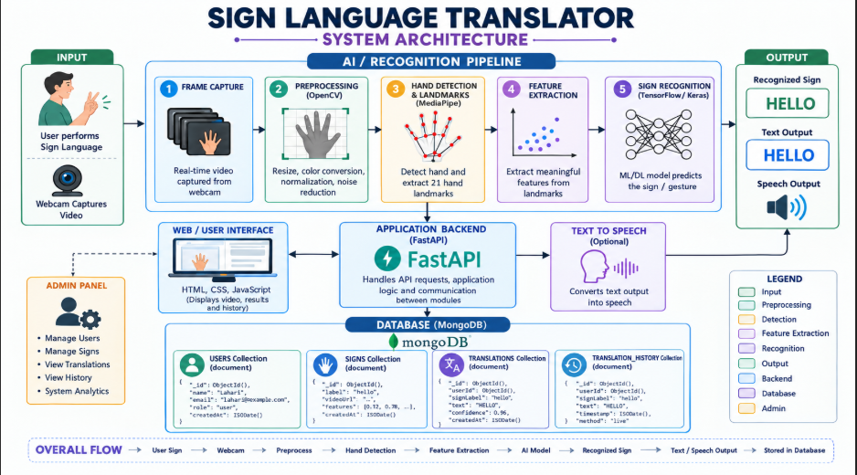
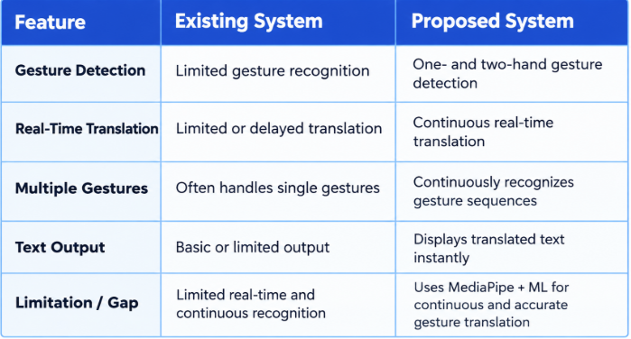
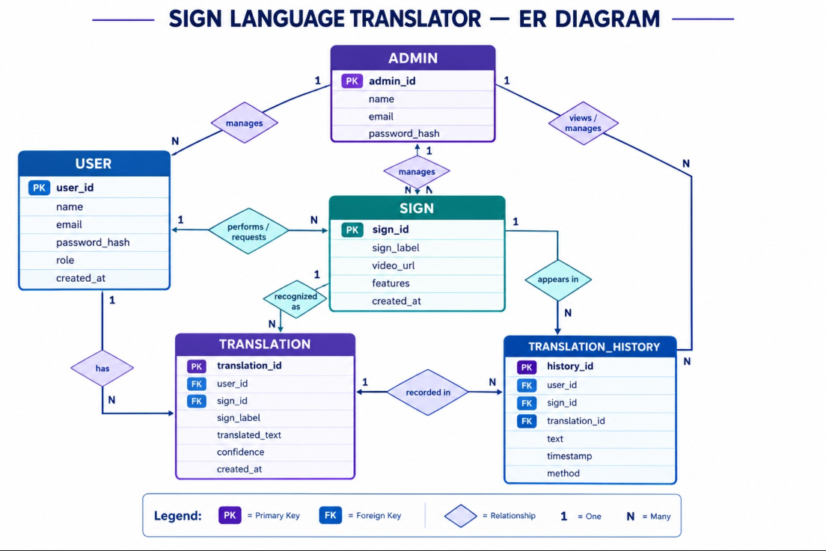
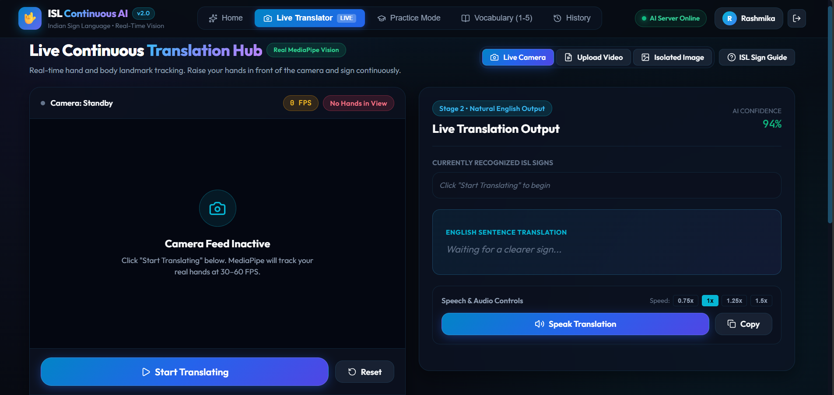
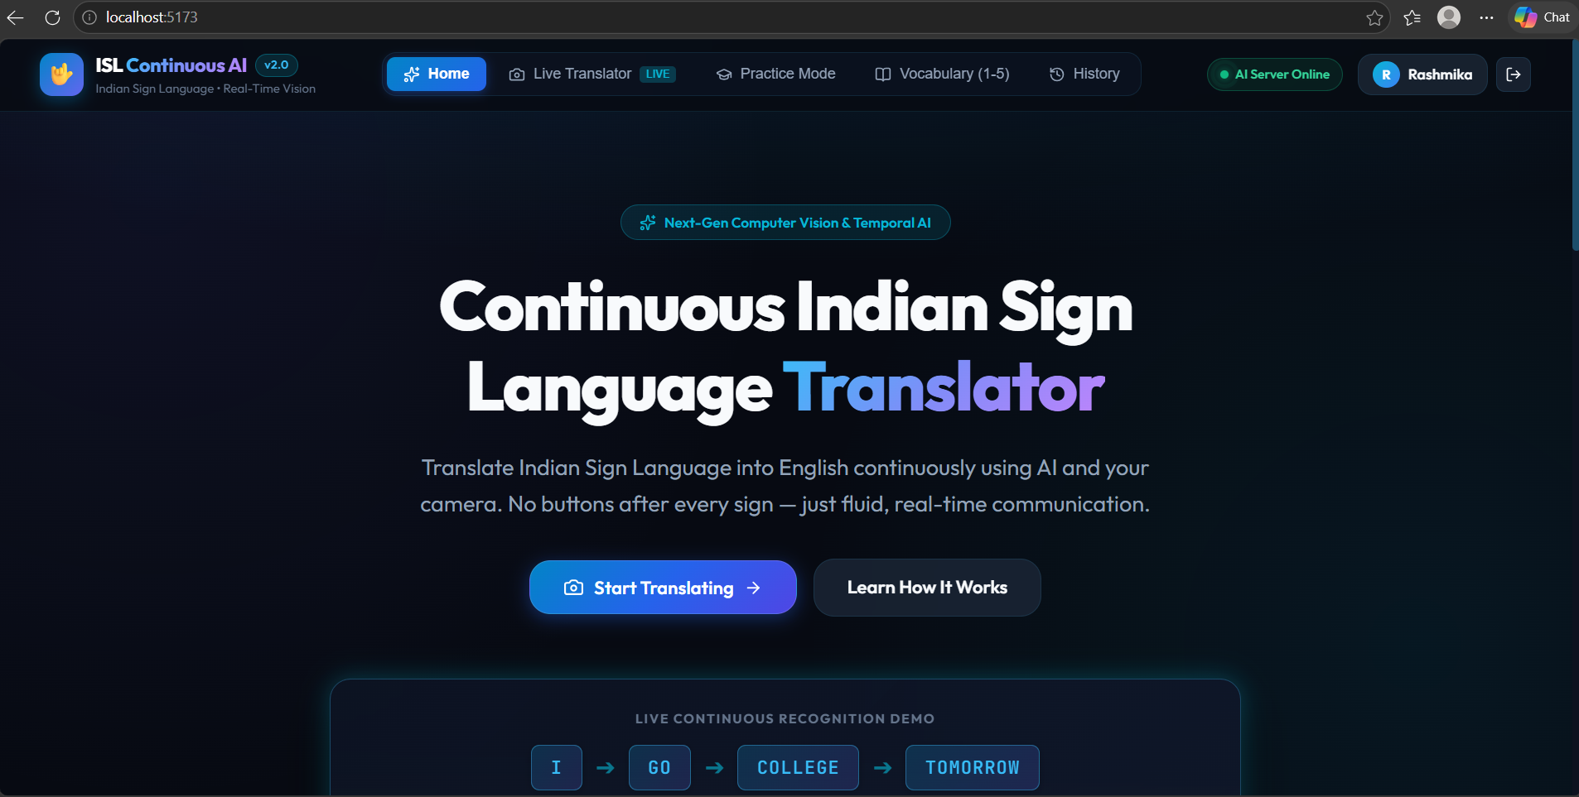
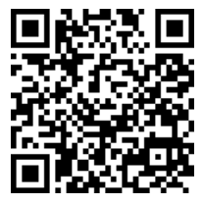
KLH Logo
SIGN LANGUAGE TRANSLATOR
Team ID: 5 | Section: S12 | Members: Allamsetti Lahari– 2520090004, Devaji Rashmika – 2520090152
| Guide: Dr. Khaja shareef
Database Systems Engineering and Distributed Backend Development (25CS1302E) | KLH Bachupally Campus, CSE | PBL 2026-27
Abstract
Tools & Technologies
Sign Language Translator: A real-time system that detects one- or two-hand gestures and converts them into text using Python, FastAPI, OpenCV, MediaPipe, and ML.
Outcome: Enables faster and accessible communication through real-time sign-to-text translation
Front-End: Streamlit + HTML/CSS
Back-End: FastAPI + REST APIs
Database: MongoDB
ML: Python + MediaPipe + Machine Learning
Tools: Git & GitHub, Postman, VS Code, Draw.io
Problem Statement & Objectives
Problem: Existing communication methods can make real-time interaction difficult for people who use sign language.
Objective 1: Detect one- and two-hand sign language gestures continuously.
Objective 2: Convert recognized gestures into text in real time.
Objective 3: Provide a simple and accessible web-based interface.
Scope: Sign-language users and general users; includes gesture detection, translation, and text display.
System Architecture
[Insert architecture diagram: Front-End – REST API – Database]
Existing vs Proposed System
ER Diagram & Database Design
Feasibility Study
Technical: Python, MediaPipe, FastAPI, Streamlit, MongoDB and ML; runs on a standard laptop with a webcam.
Economic: Low-cost solution using open-source tools and free-tier hosting; no expensive hardware required.
Operational: Simple and user-friendly interface; easy to operate, maintain and update the ML model.
Schedule: Can be completed within the semester through phased development, testing and integration.
Implementation Screenshots
[Screenshot 1]
[Screenshot 2]
Results & Testing
Conclusion
Future Scope
Key Outcomes: Real-time sign detection and text translation.
CRUD: User data and translation history management.
Validation: Accurate gesture and input validation.
Performance: Fast and responsive real-time detection.
What was achieved: Real-time sign detection and text translation.
Objectives: Improved communication through a simple and accessible translator.
Enhancement 1: Expand the system to recognize a wider range of sign language gestures and support multiple regional and international sign languages.
Enhancement 2: Improve translation accuracy using advanced AI models and add voice output for more natural and accessible communication
References: Pigou, L. et al., “Beyond Temporal Pooling: Recurrence and Convolutional Encoders for Gesture Recognition,” 2015. MediaPipe, “Hand Landmarker,” Google Developers, https://ai.google.dev/edge/mediapipe/solutions/vision/hand_landmarker Mohandes, M. et al., “Image-Based and Sensor-Based Approaches for Arabic Sign Language Recognition,” IEEE Transactions on Human-Machine Systems, 2014
QR: GitHub

